Slide 1

New flexible children policy
for theaters
王立敏
21 / 6

Slide 2
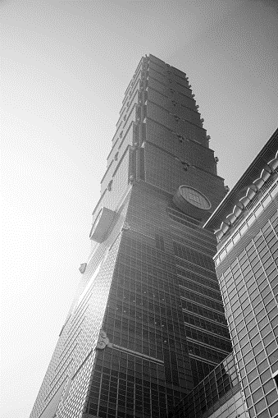
CONTENTS
PART ONE Introduction
01
PART TWO Rigid policies
02
& Benefits
PART THREE Solutions
03

Slide 3

1

Slide 4
PART ONE
Introduction
What is your impression on children?
Notes:
Let’s think a question

Slide 5

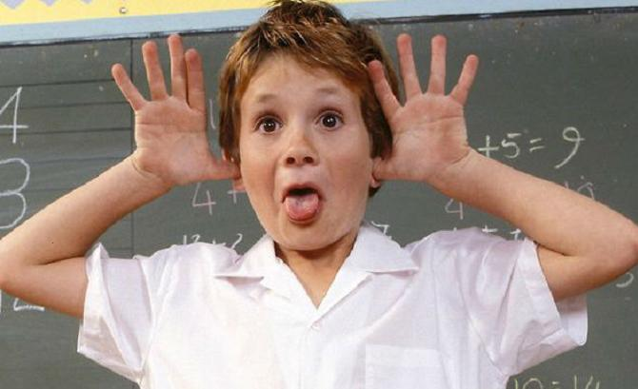
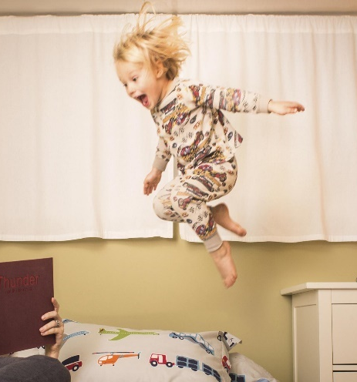
PART ONE
What is your impression on children?
Naughty
Noisy
Impatient
Notes:
Naughty: play tricks with others
Noisy: interrupt others
Impatient: always run and jump

Slide 6
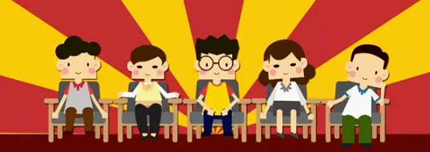
PART ONE
No Children
Notes:
But enjoy theaters needs quiet,so most of theaters do not allow children enter and enjoy the show.

Slide 7
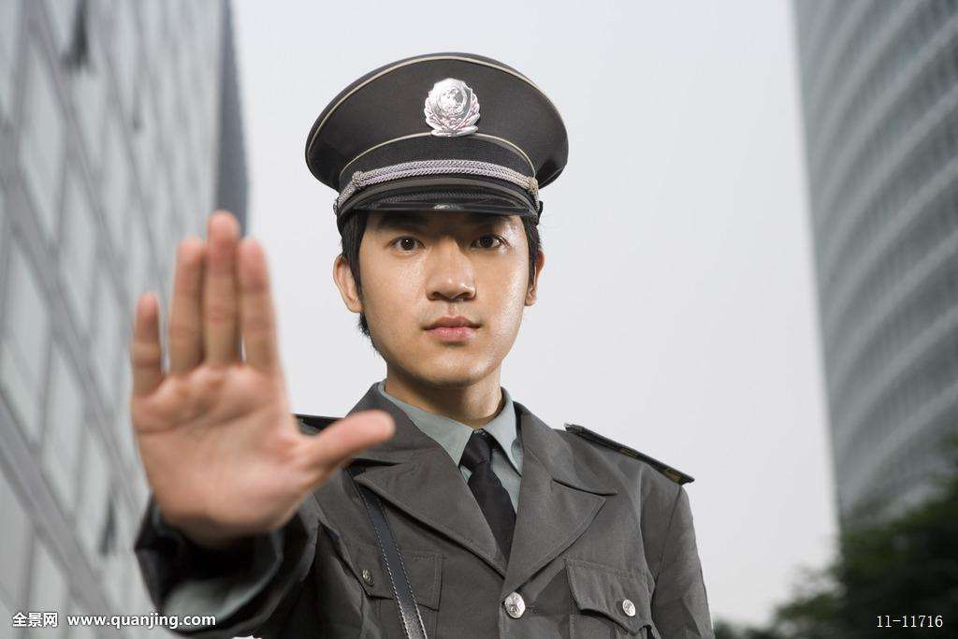

PART ONE
Imagine
Notes:
Image that there is a good popular theater, but no one help you to take care of children. So you have to buy 2tickets ,one for yourself, one for your kid. But when you take your children go to the theater, your children are refused to enter because of his low height.
And there is another situation Image that your kid have been learning piano since 3 years old, he really yearns to watch the live symphony, but he was not allowed to enter because of his early-age

Slide 8

PART ONE
Children policies are unfair
Notes:
It is unfair for some children, maybe we need new flexible children policies for theaters.

Slide 9
PART ONE
Children policies are unfair
We need new flexible Children Policies！

Slide 10
2

Slide 11

PART TWO
Rigid Policies
110cm
Children bellow 120cm are not allowed in the theatre.
Notes:
There are some policies, for example most of theaters do not allow children enter the theater

Slide 12
PART TWO
Rigid Policies
Children who looked naughty are not allowed in the theatre
Notes:
Some of theatre also have policy that “Children who looked naughty are not allowed in the theatre”,

Slide 13
PART TWO
Rigid Policies
know character from appearance
Notes:
Some researches show that the appearance is the adaptive mechanism for society, we can judge the character by looking at the faces sometimes, but it is not perfect.
We should not decide whether children could enter the theatre by just looking at their appearance
It is really funny

Slide 14
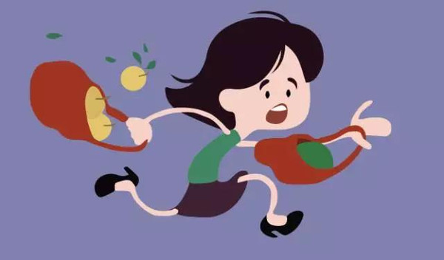
PART TWO
Children should be allowed to enter the theatre
Notes:
For parents

Slide 15
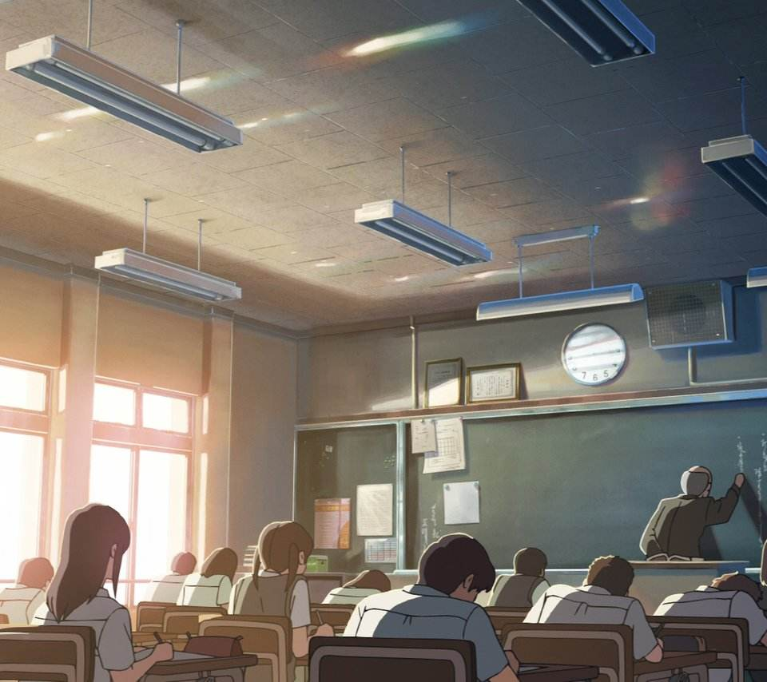
PART TWO
Beneficial
Connect the classroom with the theatre
Notes:
Actuall we should encourage children to be exposed on the theater, there is a project in Toranto, They introduce the theater into the class, teacher will organize the children to the theater. Most of them can enjoy the theaters. And they start to connect the classroom with the theater. They know where the knowledge they learned in the class come from by watching the theaters.

Slide 16
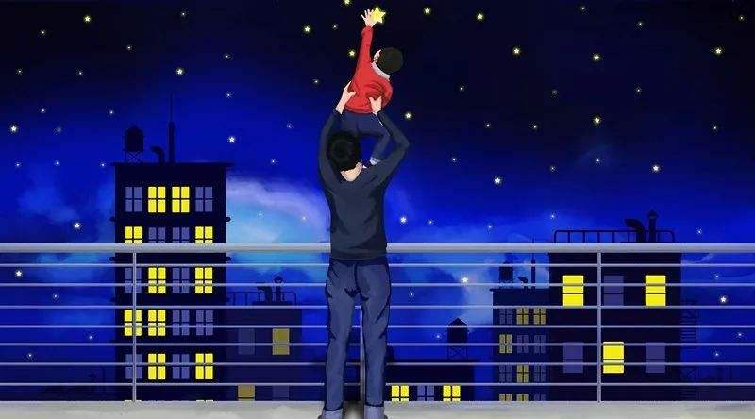
PART TWO
Beneficial
Widen the perspective

Slide 17
3

Slide 18
PART THREE
Solutions
-- children will disturb others after they enter the theatre
01
03
02
Children in the theater
Plays that are not suitable for children
● children disturb others
● remind the parents to take the children to go out for a rest.
Special region for children
● mark the notice on the tickets in advance.
● convenient
management.
Notes:
Shanghai have had an attempt to allow children into the 11 theaters， some theaters allow children enter

Slide 19
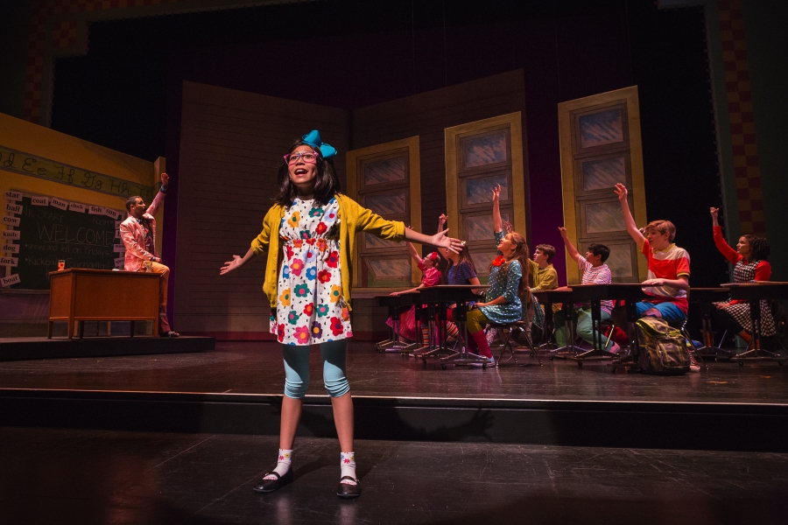
PART THREE
Solutions
-- children will disturb others after they enter the theatre
YPT(Young People Theater)
Notes:
Performed by professional adult actors

Slide 20
PART THREE
Conclusion
-- Why don’t we apply new flexible children policies
● Old policies are unfair
● Difficulties can be solved
● Really beneficial for children
Notes:
Performed by professional adult actors

Slide 21
THANK YOU

